Slide 1
Final Engagement
Attack, Defense & Analysis of a Vulnerable Network
Notes:
Subhashree

Slide 2
Table of Contents
This document contains the following resources:
Network Topology & Critical Vulnerabilities
Exploits Used
Methods Used to Avoiding Detect
Notes:
Subhashree

Slide 3
Problem Statement
Configured alert on Elk server
Noticed discrepancies with alerting in the Kibana system
Find root cause of abnormalities and find the exploitation
Notes:
Subhashree

Slide 4

Network Topology
& Critical Vulnerabilities
4
Notes:
Subhashree

Slide 5
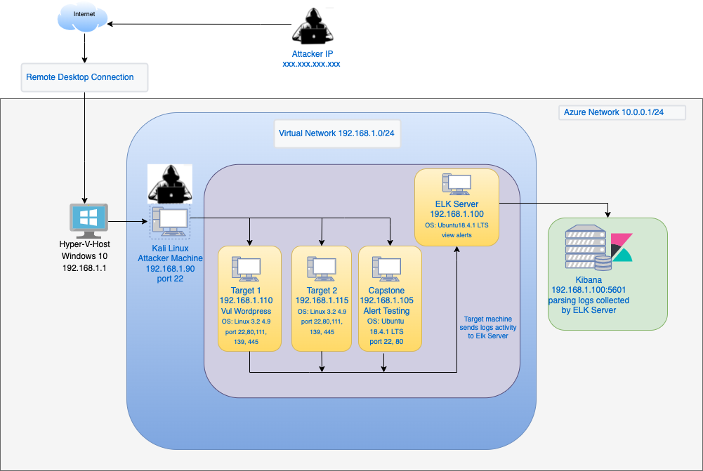
Network Topology
Network
Address Range: 192.168.1.0/24
Netmask: 255.255.255.0
Gateway: 192.168.1.1
Machines
IPv4: 192.168.1.100
OS: Ubuntu 18.04.4 LTS
Hostname: ELK
IPv4: 192.168.1.105
OS: Ubuntu 18.04.1 LTS
Hostname: Capstone
IPv4: 192.168.1.110
OS: Linux 3.2 - 4.9
Hostname: Target 1
IPv4: 192.168.1.115
OS: Linux 3.2 - 4.9
Hostname: Target 2
IPv4: 192.168.1.90
OS: Linux
Hostname: Kali
Notes:
Subhashree

Slide 6
Critical Vulnerabilities: Target 1
Our assessment uncovered the following critical vulnerabilities in Target 1.
Vulnerability | Description | Impact
Open Port and Service discovery | Nmap was used to find the open ports | The attacker could get access to active services.
User Enumeration Wordpress site | WPscan was used to get username information and hidden web files (wp-config.php) | Username info was used by attacker to gain access to the web server.
Weak User’s Password | An user (michael) had a weak password and attacker could crack it by guessing. | Attacker could SSH into the web server
Improper storage of credentials in wp-config.php | Attacker was able to locate a file containing MySQL database credentials | Able to get access to the database.
MySQL Data Exfiltration | By traversing through the databases and tables, the attacker got password hashes for all the users. | The attacker was able to crack down the password hashes using John the Ripper.
Privilege Escalation | The attacker noticed that User Steven has sudo privileges for Python. | Using steven’s password and his python privileges, and a python exploit got root access.
Notes:
Subhashree - Quick overall explanation - Nicholas to describe table

Slide 7
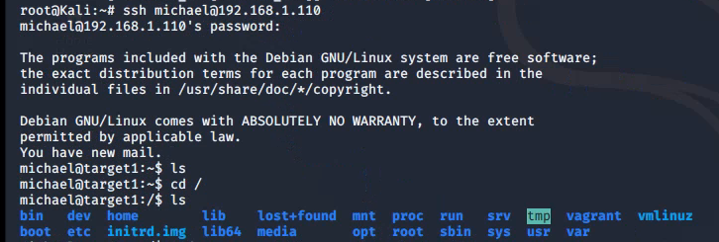
Critical Vulnerabilities: Target 1, Insecure SSH
The nmap scan revealed port 22 being open and running an SSH service. This service could potentially be hard to gain access to, but in this case it was configured with weak password. SSH is a very desirable service to exploit as an attacker, and having weak passwords is a huge security risk for this service.
With the WPScan giving us the username michael and steven we quickly discovered using michael:michael would give us access into Target 1 through SSH.
Command used: ssh michael@192.168.1.110
Notes:
Nicholas

Slide 8
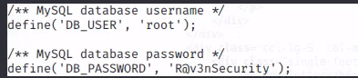
Critical Vulnerabilities: Target 1, MySQL config files
Within Target 1 there was an easily accessible file in the directory /var/www/html/wordpress which was “wp-config.php”.
From the Wordpress website “One of the most important files in your WordPress installation is the wp-config.php file. This file is located in the root of your WordPress file directory and contains your website’s base configuration details, such as database connection information.”
Being able to access this file easily to find the root user login information with a simple cat command is a huge security vulnerability.
Command used: cd /var/www/html/wordpress then use: cat wp-config.php
Notes:
Nicholas

Slide 9
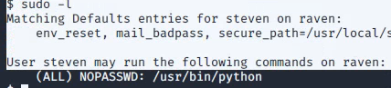
Critical Vulnerabilities: Target 1, Gaining root access
Within Target 1 the user steven had sudo privilege for /usr/bin/python commands.
This presented an opportunity for a very specific exploit which when run with sudo gives a root shell to the attacker
This is very easy to find and utilize which makes it quite a problem as a low level compromised account could then escalate privilege to root with one command.
Command used: sudo python -c ‘import pty;pty.spawn(“/bin/bash”);’
Notes:
Nicholas

Slide 10
Exploits Used
10
Notes:
Allen

Slide 11
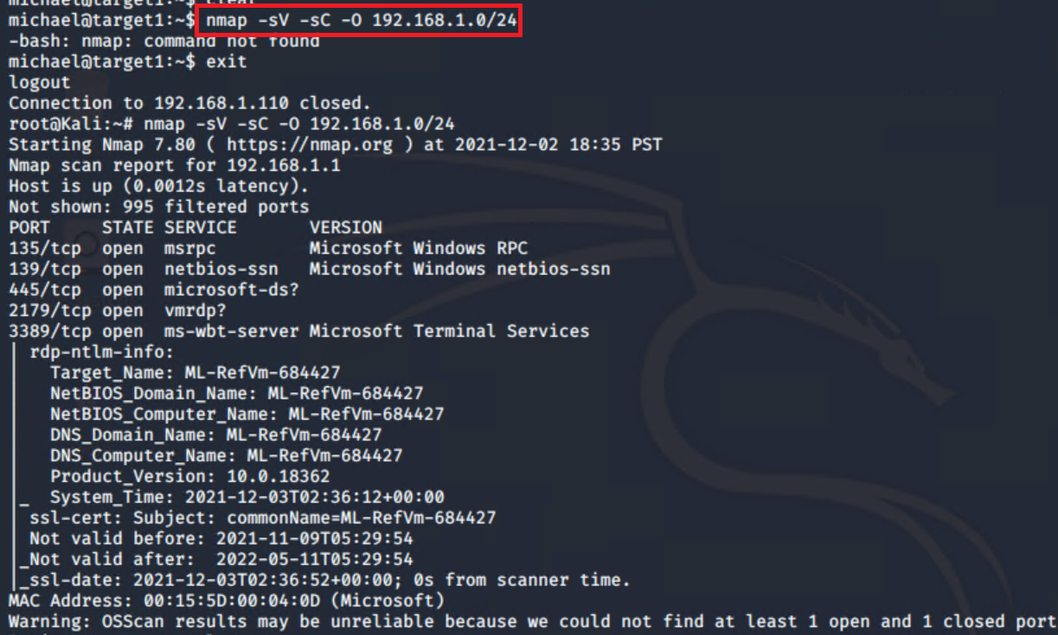
Exploitation: Open port and service discovery
01
02
Tools & Processes
Use nmap to find open ports and services
Achievements
Have overview of machines and ports on network
03
Commands:
nmap -sV -sC -O 192.168.1.0/24
Notes:
Allen

Slide 12
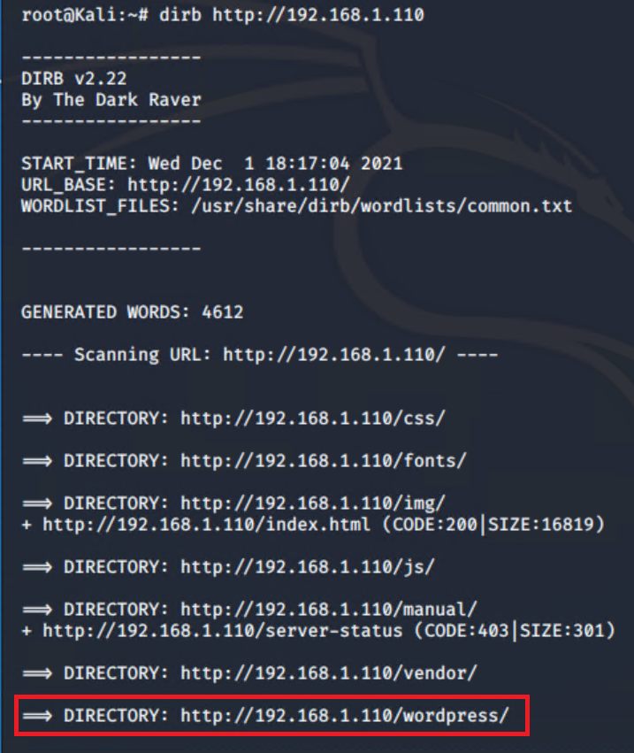
Exploitation: Hidden url directories
01
02
Tools & Processes
Use dirb to discover hidden directories
Achievements
Confirm that remote website is running wordpress
03
Commands:
dirb http://192.168.1.110
Notes:
Allen

Slide 13
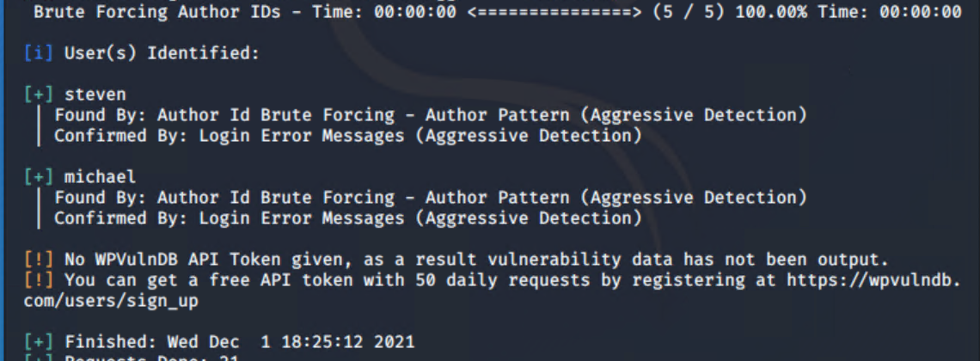
Exploitation: User enumeration of wordpress site
01
02
Tools & Processes
Use wpscan for user enumeration
Achievements
Have list of user that have access to website
03
Commands:
wpscan --url http://192.168.1.110/wordpress -enumerate u1-5
Notes:
Allen

Slide 14
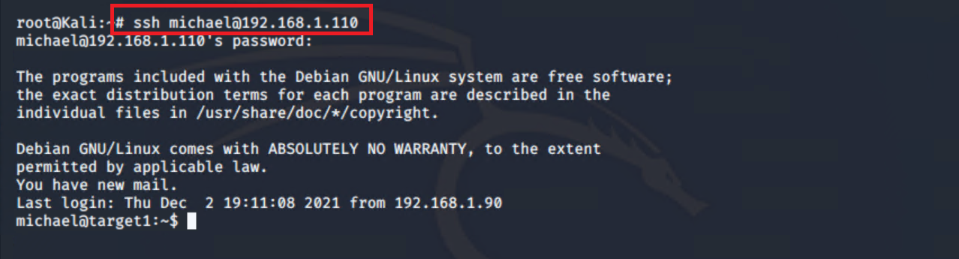
Exploitation: Weak user’s password
01
02
Tools & Processes
SSH to Target 1 machine using weak user password
Achievements
Ability to login to target 1 machine
03
Commands:
ssh michael@192.168.1.110
Guess Password : “michael”
Notes:
Sithum

Slide 15
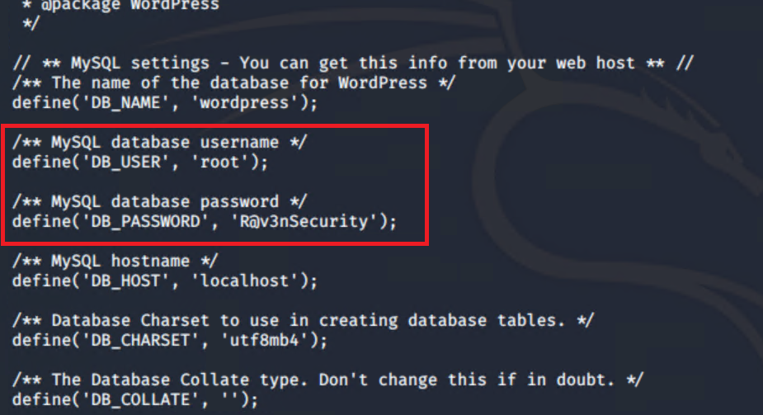
Exploitation: MySQL database access
01
02
Tools & Processes
Command to locate and access db password
Achievements
Ability to login to MySQL database
03
Commands:
cd /var/www/html/wordpress
cat wp-config.php
mysql -u root -p R@v3nSecurity -h localhost
Notes:
Sithum

Slide 16
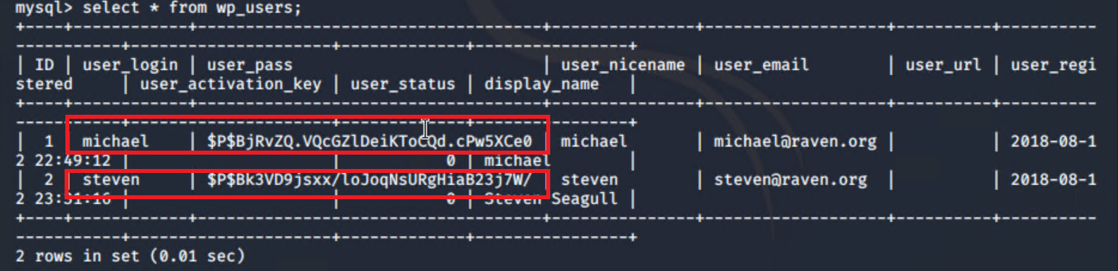
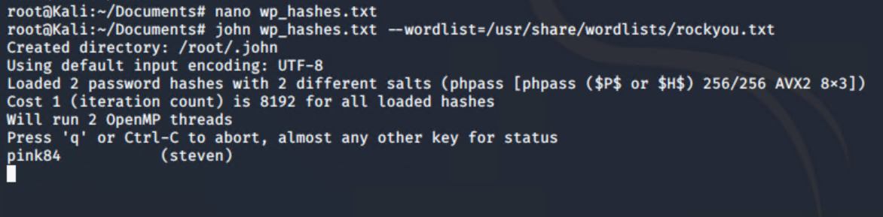
Exploitation: MySQL data exfiltration
01
02
Tools & Processes
Access MySQL db and crack password using John
Achievements
Have steven’s password
03
Commands:
mysql -u root -pR@v3nSecurity -h localhost
show database
use wordpress
select * from wp_users;
john wp_hashes.txt --wordlist-/usr/share/wordlists/rockyou..txt
Notes:
Sithum

Slide 17
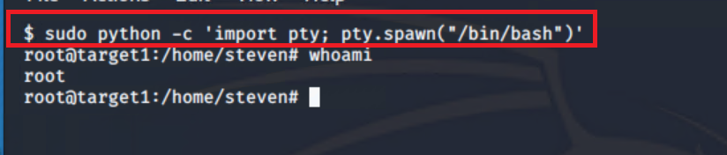
Exploitation: Privilege escalation
01
02
Tools & Processes
Use python command
Achievements
Have root access
03
Commands:
sudo python -c ‘import pty; pty.spawn(“/bin/bash”)’
Notes:
Sithum

Slide 18
Avoiding Detection
18
Notes:
Ero

Slide 19
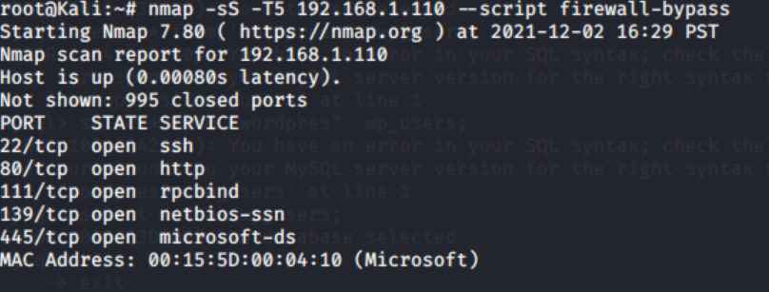
Stealth Exploitation of [Open Ports & Services]
Monitoring Overview
Which alerts detect this exploit? A filter can be activated to detect traffic from an IP connecting to different ports.
Which metrics do they measure? Set alarm if there are too many port scans.
Which thresholds do they fire at? Set a threshold of maybe 500 port scans in 5mins.
Mitigating Detection
How can you execute the same exploit without triggering the alert? -- Use polite or paranoid scans to slow down scanning. Nmap options -t0 -t1 - 6
Are there alternative exploits that may perform better? -- Use firewall bypass .
If possible, include a screenshot of your stealth technique.
Notes:
Ero

Slide 20
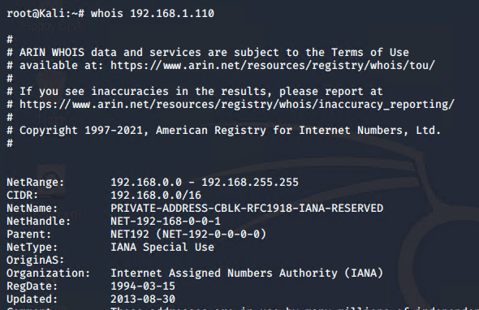
Stealth Exploitation of Hidden URL Directories
Monitoring Overview
No Alerts are currently configured to monitor Hidden URLs
Alerts were configured for Excessive HTTP errors or HTTP Request Size
Excessive HTTP errors fire anytime a 400 error is generated.
HTTP Request Size fires when bytes are greater than 3500 in one minute.
Mitigating Detection
Do not access any invalid or unauthorized pages
Query a cached version of the site
Could be accomplished via Google dorks, Shodan
Clicking through the various pages of the site slowly
Notes:
Travis

Slide 21
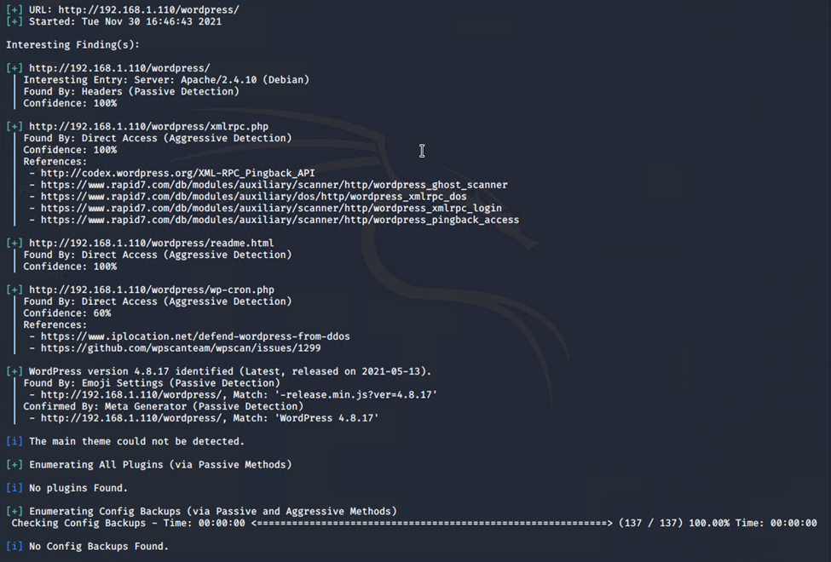
Stealth Exploitation of User enumeration of wordpress site
Monitoring Overview
Which alerts detect this exploit? HTTP Request Size Monitor
Which metrics do they measure? Total HTTP requests in bytes per 1 minute
Which thresholds do they fire at? 3500 bytes in 1 minute
Mitigating Detection
Could be accomplished via Google, Shodan
Clicking through the various pages of the site slowly
Alternative to WPscan: WordPress Exploit Framework (WordPress exploiting toolkit), WPSeku, Vane (WordPress vulnerability scanner)
Notes:
Travis

Slide 22
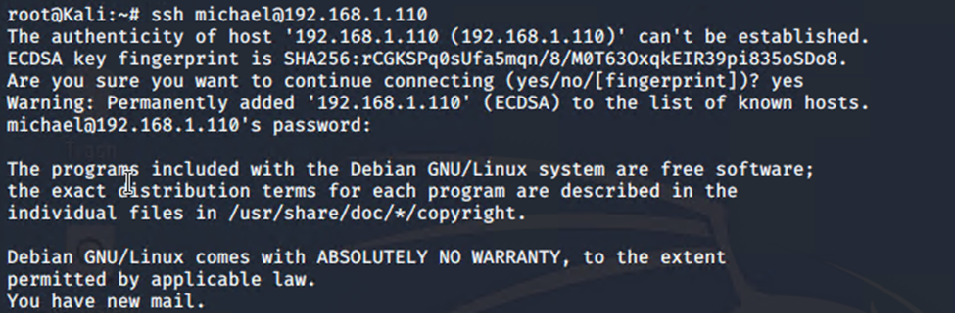
Stealth Exploitation of Weak Passwords
Monitoring Overview
Which alerts detect this exploit? SSH Logins - Filebeat
Which metrics do they measure? Success/failure/attempts at SSH login
Which thresholds do they fire at? Threshold > 0
Mitigating Detection
Not possible to SSH without triggering logging
It may be possible to POST PHP exploit to obtain shell (untested)
Bruteforce via Hydra
Notes:
Ero

Slide 23
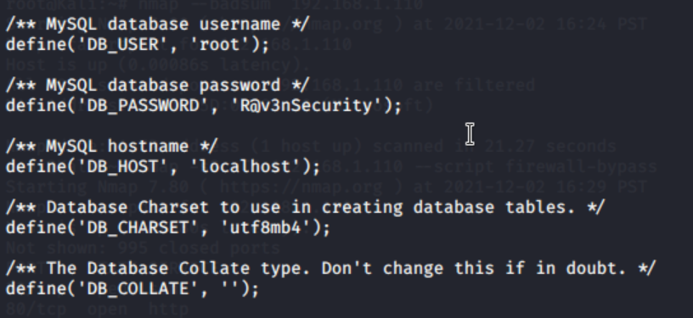
Stealth Exploitation of MySQL database access
Monitoring Overview
Which alerts detect this exploit? Database Error log - Filebeat
Which metrics do they measure? Tracks queries/error logs overtime.
Which thresholds do they fire at? Threshold > 0
Mitigating Detection
Only authorized users should access database.
Use slowlog to keep track of queries, data transferred & database resource use.
If possible, include a screenshot of your stealth technique.
Notes:
Ero

Slide 24
Stealth Exploitation of MySQL data exfiltration
Monitoring Overview
Which alerts detect this exploit? Database logs monitor - Filebeats
Which metrics do they measure? Attempted/successful/failed logins
Which thresholds do they fire at? Threshold > 0 any attempt to access database.
Mitigating Detection
Exfiltrate database to be worked on offline via meterpreter download
Are there alternative exploits that may perform better? Try hashcat to crack password.
Notes:
Travis

Slide 25
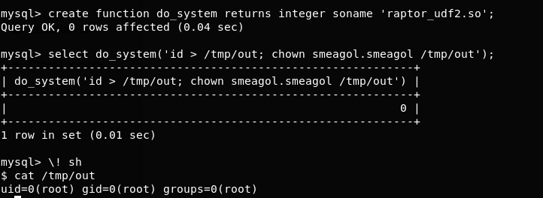
Stealth Exploitation of Privilege escalation
Monitoring Overview
Which alerts detect this exploit? Sudo Commands (Filebeat)
Which metrics do they measure? Commands used, commands by user, sudo errors
Which thresholds do they fire at? Threshold > 0
Mitigating Detection
How can you execute the same exploit without triggering the alert? Use an exploit that does not require sudo (i.e. less privilege escalation)
Are there alternative exploits that may perform better? Eternal Blue, MySQL UDF Dynamic Library
Notes:
Travis

Slide 26
Questions?
Notes:
Subhashree

Slide 27
Thank You!
Presentation By:
Allen, Ero, Nicholas,
Sithum, Subhashree, Travis
Notes:
Subhashree

